Slide 1


SCSA1603 Subject Name: Big Data Analytics Faculty Name: K.Babu
UNIT-II
DEPARTMENT OF COMPUTER SCIENCE AND ENGINEERING

Slide 2
Map-Reduce Architecture
Map-Reduce and HDFS are the two major components of Hadoop which makes it so powerful and efficient to use.
Map-Reduce is a programming model used for efficient processing in parallel over large data-sets in a distributed manner.
The data is first split and then combined to produce the final result.
The libraries for Map-Reduce is written in so many programming languages with various different-different optimizations.

Slide 3
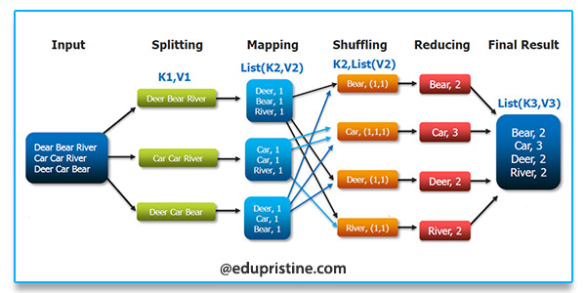

Slide 4
Components of MapReduce Architecture:
Client: The MapReduce client is the one who brings the Job to the MapReduce for processing. There can be multiple clients available that continuously send jobs for processing to the Hadoop MapReduce Manager.
Job: The MapReduce Job is the actual work that the client wanted to do which is comprised of so many smaller tasks that the client wants to process or execute.

Slide 5
Hadoop Map-Reduce Master: It divides the particular job into subsequent job-parts.
Job-Parts: The task or sub-jobs that are obtained after dividing the main job. The result of all the job-parts combined to produce the final output.
Input Data: The data set that is fed to the MapReduce for processing.
Output Data: The final result is obtained after the processing.

Slide 6
Job Tracker: The work of Job tracker is to manage all the resources and all the jobs
Task Tracker: The Task Tracker can be considered as the actual slaves that are working on the instruction given by the Job Tracker.
HDFS (Hadoop Distributed File System) is a unique design that provides storage for extremely large files with streaming data access pattern and it runs on commodity hardware. Let’s elaborate the terms

Slide 7
Extremely large files: Here we are talking about the data in range of petabytes(1000 TB).
Streaming Data Access Pattern: HDFS is designed on principle of write-once and read-many-times. Once data is written large portions of dataset can be processed any number times.
Commodity hardware: Hardware that is inexpensive and easily available in the market. This is one of feature which specially distinguishes HDFS from other file system.

Slide 8


Slide 9
Master Node:
Manages all the slave nodes and assign work to them.
It executes file system namespace operations like opening, closing, renaming files and directories.
Name Node:
Actual worker nodes, who do the actual work like reading, writing, processing etc.
They also perform creation, deletion, and replication upon instruction from the master.

Slide 10
Name nodes:
Run on the master node.
Store metadata (data about data) like file path, the number of blocks, block Ids. etc.
Require high amount of RAM.
Store meta-data in RAM for fast retrieval i.e to reduce seek time. Though a persistent copy of it is kept on disk.
Data Nodes:
Run on slave nodes.
Require high memory as data is actually stored here

Slide 11
Introduction to Pig
Pig is a high-level platform or tool which is used to process the large datasets.
It provides a high-level of abstraction for processing over the Map Reduce.
It provides a high-level scripting language, known as Pig Latin which is used to develop the data analysis codes.
First, to process the data which is stored in the HDFS, the programmers will write the scripts using the Pig Latin Language.

Slide 12
Internally Pig Engine(a component of Apache Pig) converted all these scripts into a specific map and reduce task.
But these are not visible to the programmers in order to provide a high-level of abstraction.
Pig Latin and Pig Engine are the two main components of the Apache Pig tool. The result of Pig always stored in the HDFS.

Slide 13
Need of Pig: One limitation of MapReduce is that the development cycle is very long. Writing the reducer and mapper, compiling packaging the code, submitting the job and retrieving the output is a time-consuming task.
Apache Pig reduces the time of development using the multi-query approach. Also, Pig is beneficial for the programmers who are not from Java background.
200 lines of Java code can be written in only 10 lines using the Pig Latin language. Programmers who have SQL knowledge needed less effort to learn Pig Latin.

Slide 14
Evolution of Pig: Earlier in 2006, Apache Pig was developed by Yahoo’s researchers. At that time, the main idea to develop Pig was to execute the Map-Reduce jobs on extremely large datasets. In the year 2007, it moved to Apache Software Foundation(ASF) which makes it an open source project. The first version(0.1) of Pig came in the year 2008. The latest version of Apache Pig is 0.18 which came in the year 2017.

Slide 15
Features of Apache Pig
For performing several operations Apache Pig provides rich sets of operators like the filters, join, sort, etc.
Easy to learn, read and write.
Join operation is easy in Apache Pig.
Fewer lines of code.
Apache Pig allows splits in the pipeline.
Pig can handle the analysis of both structured and unstructured data.

Slide 16
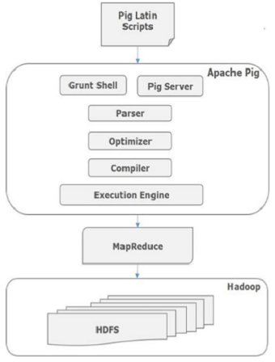

Slide 17
Parser
Initially the Pig Scripts are handled by the Parser. It checks the syntax of the script, does type checking, and other miscellaneous checks.
The output of the parser will be a DAG (directed acyclic graph), which represents the Pig Latin statements and logical operators.
In the DAG, the logical operators of the script are represented as the nodes and the data flows are represented as edges.

Slide 18
Optimizer
The logical plan (DAG) is passed to the logical optimizer, which carries out the logical optimizations such as projection and pushdown.
Compiler
The compiler compiles the optimized logical plan into a series of Map-Reduce jobs.
Execution engine
Finally the MapReduce jobs are submitted to Hadoop in a sorted order.

Slide 19
Types of Data Models in Apache Pig: It consist of the 4 types of data models as follows:
Atom: It is a atomic data value which is used to store as a string. The main use of this model is that it can be used as a number and as well as a string.
Tuple: It is an ordered set of the fields.
Bag: It is a collection of the tuples.
Map: It is a set of key/value pairs.

Slide 20
Applications of Apache Pig:
For exploring large datasets Pig Scripting is used.
Provides the supports across large data-sets for Ad-hoc queries.
In the prototyping of large data-sets processing algorithms.
Required to process the time sensitive data loads.
For collecting large amounts of datasets in form of search logs and web crawls.
Used where the analytical insights are needed using the sampling.

Slide 21
Hive Architecture
Apache Hive is an open source data warehouse system built on top of Hadoop for querying and analyzing large datasets stored in Hadoop files. It process structured and semi-structured data in Hadoop.
Hive use language called HiveQL (HQL), which is similar to SQL. HiveQL automatically translates SQL-like queries into MapReduce jobs.

Slide 22
Metastore – It stores metadata for each of the tables like their schema and location.
Driver – It acts like a controller which receives the HiveQL statements.
Compiler – It performs the compilation of the HiveQL query.
Optimizer – It performs various transformations on the execution plan to provide optimized DAG.
Executor – Once compilation and optimization complete, the executor executes the tasks. Executor takes care of pipelining the tasks.

Slide 23
Initially Hive was developed by Facebook, later the Apache Software Foundation took it up and developed it further as an open source under the name Apache Hive. It is used by different companies. For example, Amazon uses it in Amazon Elastic MapReduce.
Features of Hive
• It stores schema in a database and processed data into HDFS.
• It is designed for OLAP.
• It provides SQL type language for querying called HiveQL
• It is familiar, fast, scalable, and extensible

Slide 24
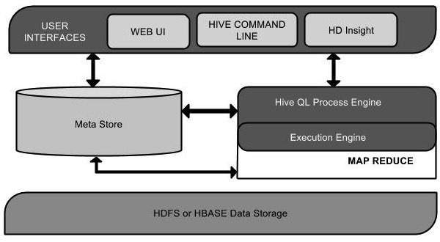

Slide 25
User Interface
Hive is a data warehouse infrastructure software that can create interaction between user and HDFS. The user interfaces that Hive supports are Hive Web UI, Hive command line, and Hive HD Insight (In Windows server).
Meta Store
Hive chooses respective database servers to store the schema or Metadata of tables, databases, columns in a table, their data types, and HDFS mapping.

Slide 26
HiveQL Process Engine
HiveQL is similar to SQL for querying on schema info on the Metastore. It is one of the replacements of traditional approach for MapReduce program. Instead of writing MapReduce program in Java, we can write a query for MapReduce job and process it
Execution Engine
The conjunction part of HiveQL process Engine and MapReduce is Hive Execution Engine. Execution engine processes the query and generates results as same as MapReduce results. It uses the flavor of MapReduce.

Slide 27
HDFS or HBASE Hadoop distributed file system or HBASE are the data storage techniques to store data into file system

Slide 28
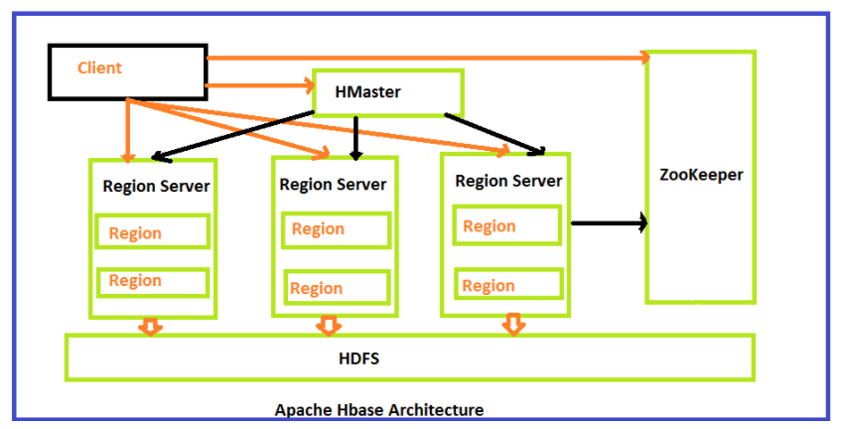
HBase Architecture

Slide 29
HBase is a Hadoop project which is Open Source, distributed Hadoop database which has its genesis in the Google’s Bigtable.
Its programming language is Java.
Now, it is an integral part of the Apache Software Foundation and the Hadoop ecosystem.
Also, it is a high availability database which exclusively runs on top of the HDFS.
It is a column-oriented database built on top of HDFS.

Slide 30
HBase architecture consists mainly of four components
HMaster
HRegionserver
HRegions
Zookeeper
HDFS

Slide 31
HMaster
HMaster in HBase is the implementation of a Master server in HBase architecture. It acts as a monitoring agent to monitor all Region Server instances present in the cluster and acts as an interface for all the metadata changes.

Slide 32
The following are important roles performed by HMaster in HBase.
Plays a vital role in terms of performance and maintaining nodes in the cluster.
HMaster provides admin performance and distributes services to different region servers.
HMaster assigns regions to region servers.
HMaster has the features like controlling load balancing and failover to handle the load over nodes present in the cluster.

Slide 33
Some of the methods exposed by HMaster Interface are primarily Metadata oriented methods.
Table (createTable, removeTable, enable, disable)
Column Family (add Column, modify Column)
Region (move, assign)

Slide 34
HBase Region Servers
When HBase Region Server receives writes and read requests from the client, it assigns the request to a specific region, where the actual column family resides.
HMaster can get into contact with multiple HRegion servers and performs the following functions.
Hosting and managing regions
Splitting regions automatically
Handling read and writes requests
Communicating with the client directly

Slide 35
HBase Regions
HRegions are the basic building elements of HBase cluster that consists of the distribution of tables and are comprised of Column families. It contains multiple stores, one for each column family. It consists of mainly two components, which are Memstore and Hfile.

Slide 36
HBase Data Model
HBase Tables – Logical collection of rows stored in individual partitions known as Regions.
HBase Row – Instance of data in a table.
Row Key - HBase table is identified and indexed by a Row Key.
Columns - Number of attributes can be stored.
Column Family – Data in rows is grouped together as column families and all columns are stored together in a low level storage file known as HFile.

Slide 37
ZooKeeper
ZooKeeper is a distributed co-ordination service to manage large set of hosts. Co-ordinating and managing a service in a distributed environment is a complicated process. ZooKeeper solves this issue with its simple architecture and API.
Distributed Application
A distributed application can run on multiple systems in a network at a given time (simultaneously) by coordinating among themselves to complete a particular task in a fast and efficient manner.

Slide 38
Normally, complex and time-consuming tasks, which will take hours to complete by a non-distributed application (running in a single system) can be done in minutes by a distributed application
A distributed application has two parts, Server and Client application. Server applications are actually distributed and have a common interface so that clients can connect to any server in the cluster and get the same result.

Slide 39
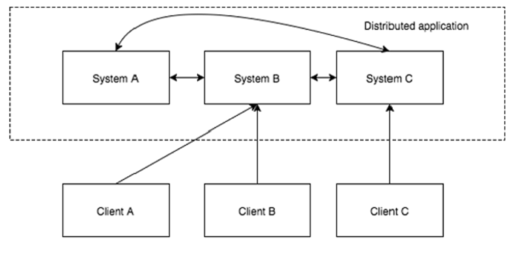

Slide 40
Benefits of Distributed Applications
Reliability − Failure of a single or a few systems does not make the whole system to fail.
Scalability − Performance can be increased as and when needed by adding more machines with minor change in the configuration of the application with no downtime.
Transparency − Hides the complexity of the system and shows itself as a single entity / application.

Slide 41
Challenges of Distributed Applications
Race condition − Two or more machines trying to perform a particular task, which actually needs to be done only by a single machine at any given time. For example, shared resources should only be modified by a single machine at any given time.
Deadlock − Two or more operations waiting for each other to complete indefinitely.
Inconsistency − Partial failure of data.

Slide 42
Benefits of Zookeeper
Simple distributed coordination process
Synchronization − Mutual exclusion and co-operation between server processes.
Serialization − Encode the data according to specific rules.
Atomicity − Data transfer either succeed or fail completely, but no transaction is partial.

Slide 43
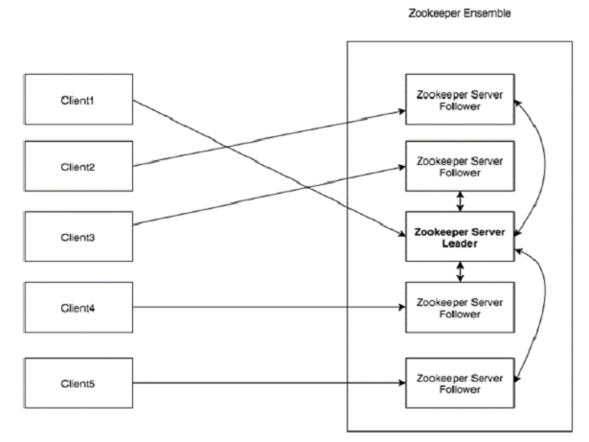
Architecture of Zookeeper

Slide 44
Client | Clients, one of the nodes in our distributed application cluster, access information from the server. For a particular time interval, every client sends a message to the server to let the sever know that the client is alive. Similarly, the server sends an acknowledgement when a client connects. If there is no response from the connected server, the client automatically redirects the message to another server.

Slide 45
Server | Provides all the services to clients. Gives acknowledgement to client to inform that the server is alive.
Ensemble | Group of Zookeeper servers. The minimum number of nodes that is required to form an ensemble is 3.
Leader | Server node which performs automatic recovery if any of the connected node failed. Leaders are elected on service startup.
Follower | Server node which follows leader instruction.

Slide 46
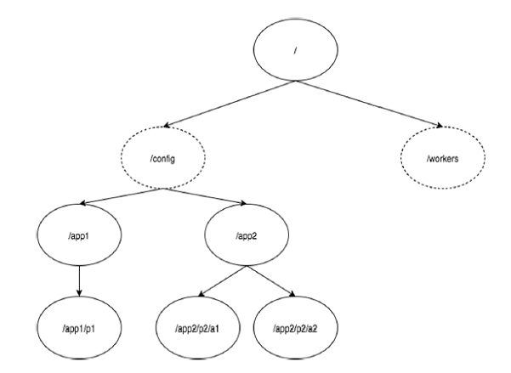
Hierarchical Namespace

Slide 47
In the diagram, first you have a root znode separated by “/”. Under root, you have two logical namespaces config and workers.
The config namespace is used for centralized configuration management and the workers namespace is used for naming.
Under config namespace, each znode can store upto 1MB of data.
The main purpose of this structure is to store synchronized data and describe the metadata of the znode. This structure is called as ZooKeeper Data Model.

Slide 48
Action Control List (ACL) − ACL is basically an authentication mechanism for accessing the znode. It governs all the znode read and write operations.
Timestamp − Timestamp represents time elapsed from znode creation and modification.
Zxid is unique and maintains time for each transaction so that you can easily identify the time elapsed from one request to another request.

Slide 49
Data length − Total amount of the data stored in a znode is the data length. You can store a maximum of 1MB of data.
Sessions
Sessions are very important for the operation of ZooKeeper. Requests in a session are executed in FIFO order. Once a client connects to a server, the session will be established and a session id is assigned to the client.

Slide 50
The client sends heartbeats at a particular time interval to keep the session valid. If the ZooKeeper ensemble does not receive heartbeats from a client for more than the period (session timeout) specified at the starting of the service, it decides that the client died.
Watches
Clients can set watches while reading a particular znode. Watches send a notification to the registered client for any of the znode (on which client registers) changes.

Slide 51
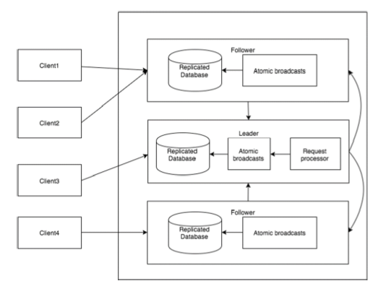
Zookeeper - Workflow

Slide 52
Write | Write process is handled by the leader node. The leader forwards the write request to all the znodes and waits for answers from the znodes. If half of the znodes reply, then the write process is complete.
Read | Reads are performed internally by a specific connected znode, so there is no need to interact with the cluster.

Slide 53
Replicated Database | It is used to store data in zookeeper. Each znode has its own database and every znode has the same data at every time with the help of consistency.
Leader | Leader is the Znode that is responsible for processing write requests.
Follower | Followers receive write requests from the clients and forward them to the leader znode.

Slide 54
Request Processor | Present only in leader node. It governs write requests from the follower node.
Atomic broadcasts | Responsible for broadcasting the changes from the leader node to the follower nodes.

Slide 55
IBM InfoSphere BigInsights
IBM provides extensive capabilities, including installation and management facilities and additional tools and utilities. Special care is taken to ensure that InfoSphere BigInsights is 100% compatible with open source Hadoop.
The IBM capabilities provide the Hadoop developer or administrator with additional choices and flexibility without locking them into proprietary technology.

Slide 56
Here are some of the standard open source utilities in InfoSphere
PIG
Hive / HCatalog
Oozie
HBASE
Zookeeper
Flume
Avro
Chukwa

Slide 57
Key software capabilities Big SQL has several ad-vantages over competing SQL on Hadoop implementations:
SQL language compatibility
Performance
Security

Slide 58
Big Sheets: Big Sheets is a spreadsheet style data manipulation and visualization tool that allows business users to access and analyze data in Hadoop without the need to be knowledgeable in Hadoop scripting languages or MapReduce programming.
Using built-in line readers, BigSheets can import data in multiple formats. In this example, it is importing data that is stored in Hive.

Slide 59
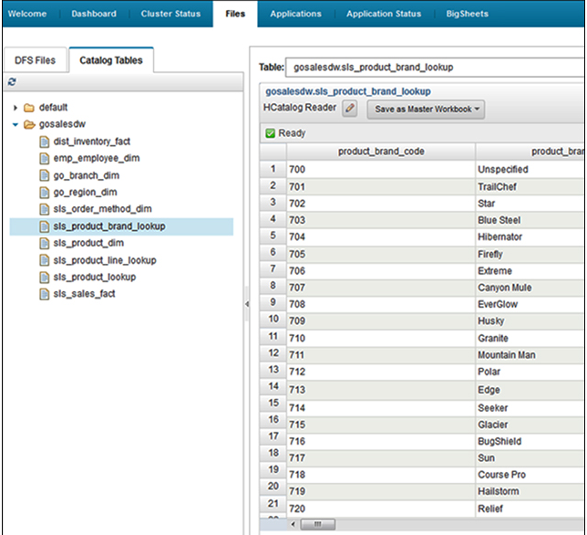

Slide 60
InfoSphere BigSheets interface
Application Accelerators: Big data use cases to build quickly high-quality applications
Text Analytics Accelerators: A set of facilities for developing applications that analyze text across multiple spoken languages
Machine Data Accelerators: Easy to develop applications that process log files, including web logs, mail logs, and various specialized file formats
Social Data Accelerators: Tools to easily import and analyze social data at scale from multiple online sources, including tweets, boards, and blogs

Slide 61
Additional deployment models
Clients do not want to be bothered with acquiring and maintain a Hadoop on cluster on their own premises.
Data that is stored and processed on Hadoop comes largely from external sources as opposed to local data sources (such as cloud-based social media aggregators).
Clients want to retain the flexibility to alter the size of clusters up and down based on changing requirements.

Slide 62
ETL is a process and it stands for Extract, Transform and Load. It is a process in which an ETL tool extracts the data from various data source systems, transforms it in the staging area, and then finally, loads it into the system.

Slide 63
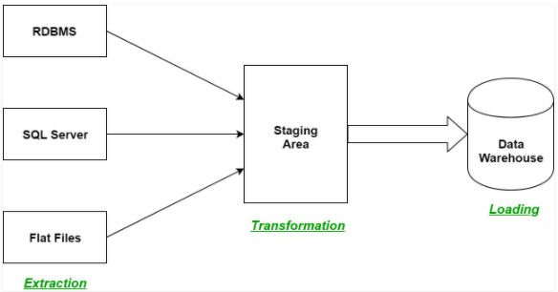

Slide 64
Extraction:
In this step, data from various source systems is extracted which can be in various formats like relational databases, No SQL, XML, and flat files into the staging area. It is important to extract the data from various source systems and store it into the staging area first and not directly into the data warehouse because the extracted data is in various formats and can be corrupted also. Hence loading it directly into the data warehouse may damage it and rollback will be much more difficult. Therefore, this is one of the most important steps of ETL process.

Slide 65
Transformation:
In this step, a set of rules or functions are applied on the extracted data to convert it into a single standard format.
Filtering – loading only certain attributes into the data warehouse.
Cleaning – filling up the NULL values with some default values, mapping U.S.A, United States, and America into USA, etc.
Joining – joining multiple attributes into one.
Splitting – splitting a single attribute into multiple attributes.
Sorting – sorting tuples on the basis of some attribute

Slide 66
Loading:
The third and final step of the ETL process is loading. In this step, the transformed data is finally loaded into the data warehouse. Sometimes the data is updated by loading into the data warehouse very frequently and sometimes it is done after longer but regular intervals.

Slide 67
What is Flume?
Apache Flume is a tool/service/data mechanism for collecting aggregating and transporting large amounts of streaming data such as log files, events (etc...) from various sources to a centralized data store.
Flume is a highly reliable, distributed, and configurable tool. It is principally designed to copy streaming data (log data) from various web servers to HDFS.

Slide 68
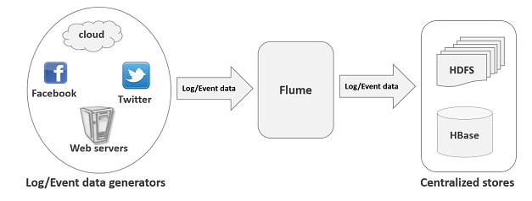

Slide 69
Advantages of Flume
Using Apache Flume we can store the data into any of the centralized stores (HBase, HDFS).
Flume acts as a mediator between data producers and the centralized stores and provides a flow of data between them.
The transactions in Flume are channel-based where two transactions (one sender and one receiver) are maintained for each message. It guarantees reliable message delivery.
Flume is reliable, fault tolerant, scalable, manageable, and customizable.

Slide 70
Features of Flume
Flume ingests log data from multiple web servers into a centralized store (HDFS, HBase) efficiently.
Using Flume, we can get the data from multiple servers immediately into Hadoop.
Flume is also used to import huge volumes of event data produced by social networking sites like Facebook and Twitter, and e-commerce websites like Amazon and Flipkart.
Flume supports a large set of sources and destinations types.

Slide 71
The following illustration depicts the basic architecture of Flume. As shown in the illustration, data generators (such as Facebook, Twitter) generate data which gets collected by individual Flume agents running on them. Thereafter, a data collector (which is also an agent) collects the data from the agents which is aggregated and pushed into a centralized store such as HDFS or HBase.

Slide 72
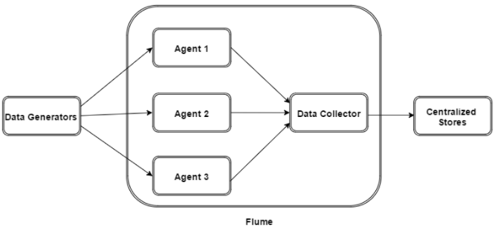

Slide 73

Flume Event
An event is the basic unit of the data transported inside Flume. It contains a payload of byte array that is to be transported from the source to the destination accompanied by optional headers

Slide 74
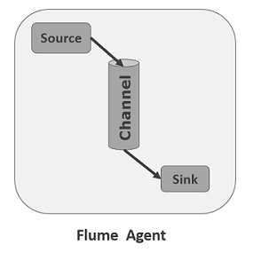
Flume Agent
An agent is an independent daemon process (JVM) in Flume. It receives the data (events) from clients or other agents and forwards it to its next destination (sink or agent). Flume may have more than one agent.

Slide 75
Source
A source is the component of an Agent which receives data from the data generators and transfers it to one or more channels in the form of Flume events.
Channel
A channel is a transient store which receives the events from the source and buffers them till they are consumed by sinks. It acts as a bridge between the sources and the sinks.

Slide 76
Sink
A sink stores the data into centralized stores like HBase and HDFS. It consumes the data (events) from the channels and delivers it to the destination. The destination of the sink might be another agent or the central stores.
Interceptors
Interceptors are used to alter/inspect flume events which are transferred between source and channel.

Slide 77
Channel Selectors
These are used to determine which channel is to be opted to transfer the data in case of multiple channels. There are two types of channel selectors −
Default channel selectors − These are also known as replicating channel selectors they replicates all the events in each channel.
Multiplexing channel selectors − These decides the channel to send an event based on the address in the header of that event.

Slide 78
Flume is a framework which is used to move log data into HDFS. Generally events and log data are generated by the log servers and these servers have Flume agents running on them. These agents receive the data from the data generators.
The data in these agents will be collected by an intermediate node known as Collector. Just like agents, there can be multiple collectors in Flume.
Finally, the data from all these collectors will be aggregated and pushed to a centralized store such as HBase or HDFS. The following diagram explains the data flow in Flume.

Slide 79
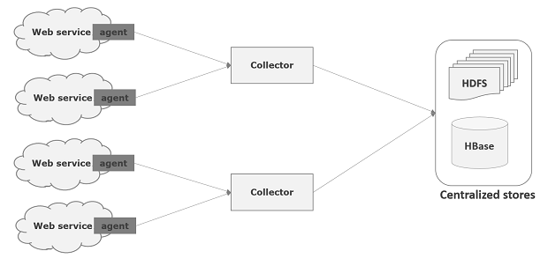

Slide 80
Multi-hop Flow
Within Flume, there can be multiple agents and before reaching the final destination, an event may travel through more than one agent. This is known as multi-hop flow.
Fan-out Flow
The dataflow from one source to multiple channels is known as fan-out flow. It is of two types −
Replicating − The data flow where the data will be replicated in all the configured channels.
Multiplexing − Data will be sent to a selected channel which is mentioned in the header of the event.

Slide 81
Fan-in Flow
The data flow in which the data will be transferred from many sources to one channel is known as fan-in flow.
Failure Handling
In Flume, for each event, two transactions take place: one at the sender and one at the receiver. The sender sends events to the receiver. Soon after receiving the data, the receiver commits its own transaction and sends a “received” signal to the sender. After receiving the signal, the sender commits its transaction. (Sender will not commit its transaction till it receives a signal from the receiver.)

Slide 82
KAFKA
The first challenge is how to collect large volume of data and the second challenge is to analyze the collected data. To overcome those challenges, you must need a messaging system.
Kafka is designed for distributed high throughput systems. In comparison to other messaging systems, Kafka has better throughput, built-in partitioning, replication and inherent fault-tolerance, which makes it a good fit for large-scale message processing applications.

Slide 83
What is a Messaging System?
A Messaging System is responsible for transferring data from one application to another, so the applications can focus on data, but not worry about how to share it. Distributed messaging is based on the concept of reliable message queuing.
Two types of messaging patterns are available − one is point to point and the other is publish-subscribe (pub-sub) messaging system. Most of the messaging patterns follow pub-sub.

Slide 84
Point to Point Messaging System
In a point-to-point system, messages are persisted in a queue. One or more consumers can consume the messages in the queue, but a particular message can be consumed by a maximum of one consumer only. Once a consumer reads a message in the queue, it disappears from that queue. The typical example of this system is an Order Processing System, where each order will be processed by one Order Processor, but Multiple Order Processors can work as well at the same time. The following diagram depicts the structure.

Slide 85
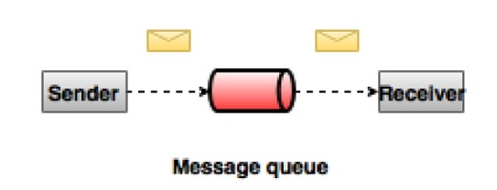

Slide 86
Publish-Subscribe Messaging System
In the publish-subscribe system, messages are persisted in a topic. Unlike point-to-point system, consumers can subscribe to one or more topic and consume all the messages in that topic. In the Publish-Subscribe system, message producers are called publishers and message consumers are called subscribers. A real-life example is Dish TV, which publishes different channels like sports, movies, music, etc., and anyone can subscribe to their own set of channels and get them whenever their subscribed channels are available.

Slide 87
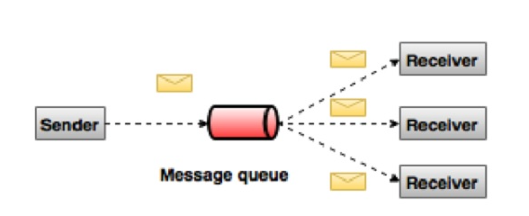

Slide 88
What is Kafka?
Apache Kafka is a distributed publish-subscribe messaging system and a robust queue that can handle a high volume of data and enables you to pass messages from one end-point to another. Kafka is suitable for both offline and online message consumption. Kafka messages are persisted on the disk and replicated within the cluster to prevent data loss.

Slide 89
Benefits
Reliability − Kafka is distributed, partitioned, replicated and fault tolerance.
Scalability − Kafka messaging system scales easily without down time..
Durability − Kafka uses Distributed commit log which means messages persists on disk as fast as possible, hence it is durable..
Performance − Kafka has high throughput for both publishing and subscribing messages. It maintains stable performance even many TB of messages are stored.

Slide 90
Use Cases
Metrics − Kafka is often used for operational monitoring data.
Log Aggregation Solution − Kafka can be used across an organization to collect logs from multiple services and make them available in a standard format to multiple consumers.
Stream Processing − Popular frameworks such as Storm and Spark Streaming read data from a topic, processes it, and write processed data to a new topic where it becomes available for users and applications. Kafka’s strong durability is also very useful in the context of stream processing.

Slide 91
Need for Kafka
Kafka is a unified platform for handling all the real-time data feeds. It has the ability to handle a large number of diverse consumers.

Slide 92
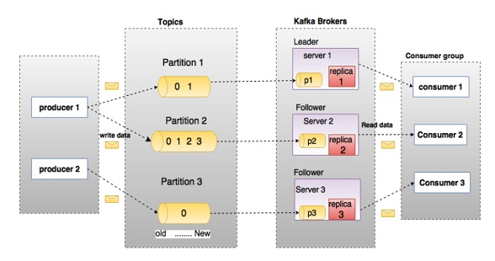

Slide 93
Topics A stream of messages belonging to a particular category is called a topic. Data is stored in topics. Topics are split into partitions. For each topic, Kafka keeps a mini-mum of one partition. Each such partition contains messages in an immutable ordered sequence. A partition is implemented as a set of segment files of equal sizes.
Partition Topics may have many partitions, so it can handle an arbitrary amount of data.

Slide 94
Partition offset Each partitioned message has a unique sequence id called as offset.
Replicas of partition Replicas are nothing but backups of a partition. Replicas are never read or write data. They are used to prevent data loss.
Brokers Brokers are simple system responsible for maintaining the published data.

Slide 95
Producers Producers are the publisher of messages to one or more Kafka topics. Producers send data to Kafka brokers. Every time a producer publishes a message to a broker, the broker simply appends the message to the last segment file. Producer can also send messages to a partition of their choice.
Consumers Consumers read data from brokers. Consumers subscribes to one or more topics and consume published messages by pulling data from the brokers.

Slide 96
Leader Leader is the node responsible for all reads and writes for the given partition. Every partition has one server acting as a leader.
Follower Node which follows leader instructions are called as follower. If the leader fails, one of the follower will automatically become the new leader. A follower acts as normal consumer, pulls messages and up-dates its own data store.

Slide 97
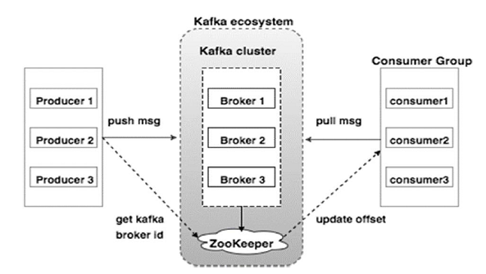

Slide 98
Broker
Kafka cluster typically consists of multiple brokers to maintain load balance. Kafka brokers are stateless, so they use ZooKeeper for maintaining their cluster state.
ZooKeeper
ZooKeeper is used for managing and coordinating Kafka broker. ZooKeeper service is mainly used to notify producer and consumer about the presence of any new broker in the Kafka system or failure of the broker in the Kafka system.

Slide 99
Producers
Producers push data to brokers. When the new broker is started, all the producers search it and automatically sends a message to that new broker. Kafka producer doesn’t wait for acknowledgements from the broker and sends messages as fast as the broker can handle.

Slide 100
Consumers
Since Kafka brokers are stateless, which means that the consumer has to maintain how many messages have been consumed by using partition offset. If the consumer acknowledges a particular message offset, it implies that the consumer has consumed all prior messages.

